Slide 1
Hanz-Day-Out System Analysis
By: Jeremy Wisecarver and Parker Weisel

Slide 2
Coeur D’Alene Top-Down Dev Team
Jeremy Wisecarver
Parker Weisel

Slide 3
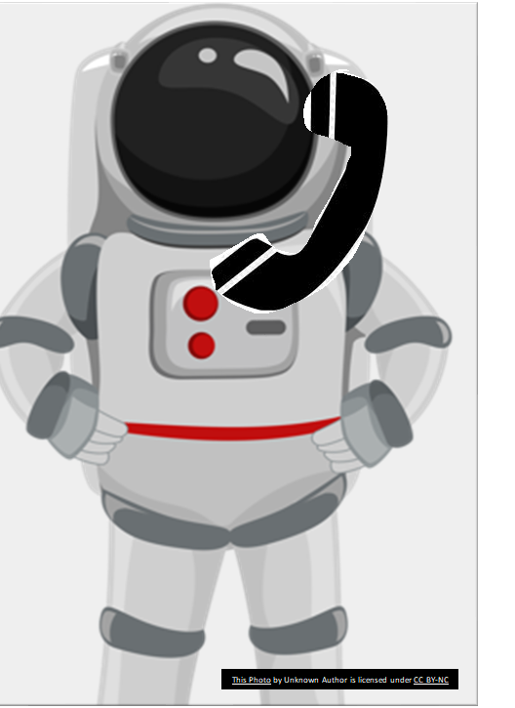
Dialogue: (Phone call) Hello Hanz! Its me, your boss at Space-Mining inc. I’m calling to inform you that you have been fired from your job! (Hanz) How dare you! After all my years of loyalty you will pay for this!
Action:
Player: Leaves the house to begin hunting for your boss.

Slide 4
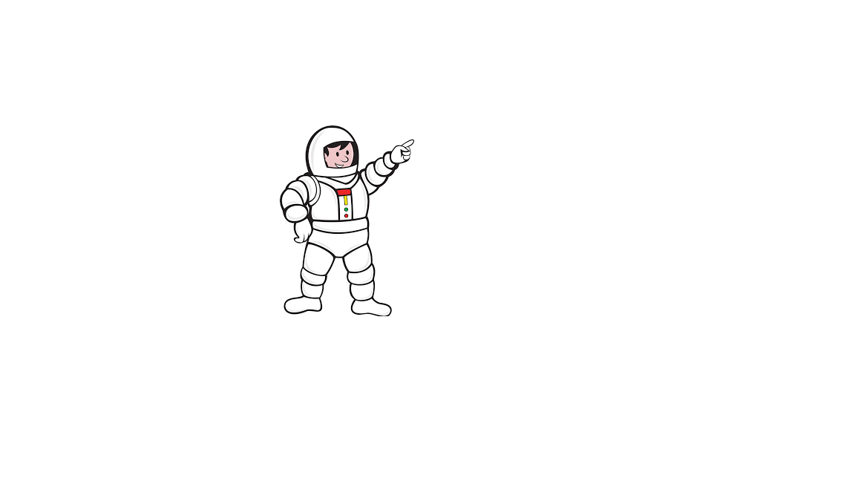
Dialogue: (Co-workers)Ha!-Ha! Its Hanz! I heard he got fired from his job!
(Hanz) How dare you insult me like this! You will pay for insulting me over my current lack of job!
Action:
Player: Attacks the co-workers while the co-workers attempt to fight back

Slide 5
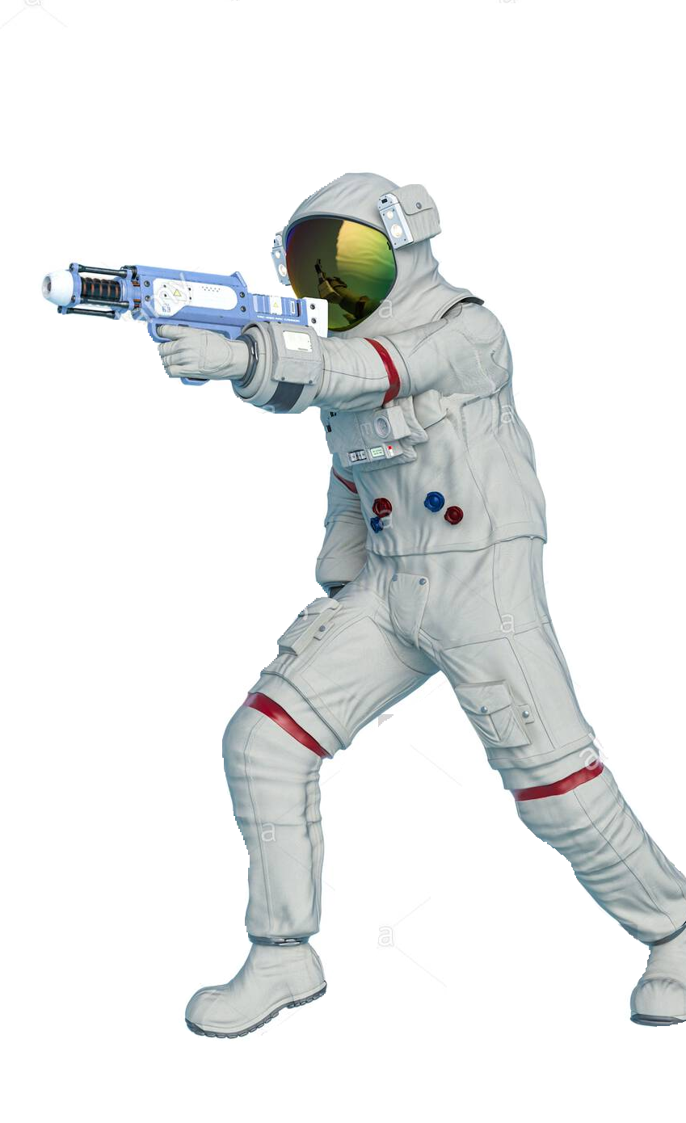
Action:
Player: Rampages through the planet collecting items to increase power and defeating his former co-workers.

Slide 6

Dialogue: (Space police officer) Stop right there Hanz! This is the space police! Come peacefully with your “Hanz” up! You are under arrest!
(Hanz) You will never take me alive!
Action:
Player enters combat with the more powerful space police.

Slide 7
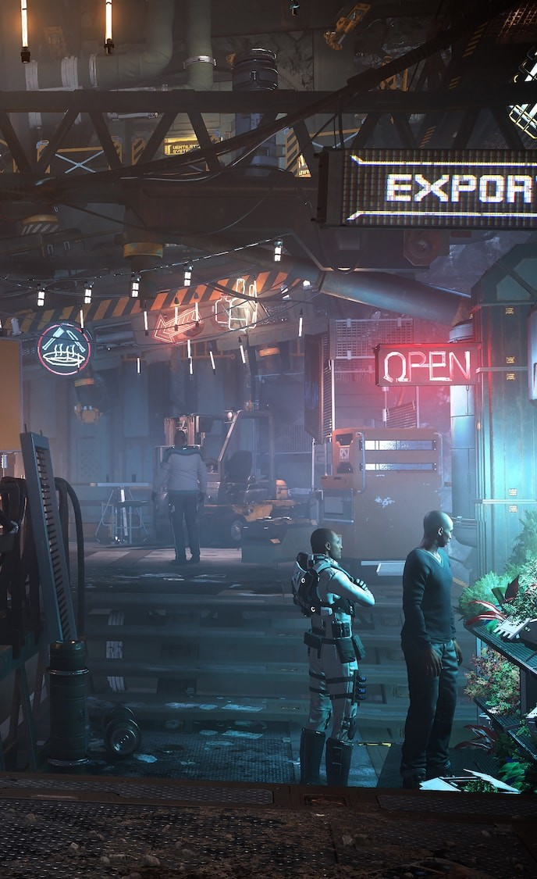
Player:
*Finds and enters the black market*
Dialogue: (Black market dealer)Ahh greetings Hanz welcome to the black market! You must have some quick “hanz” to be able to defeat the space police force like that!
(Hanz) I am going to rob you for your that pun.
Action:
Player robs the black market for better gear.

Slide 8

Player:
Enters Hanz’s workplace and begins to fight off security in an attempt to reach his boss.

Slide 9
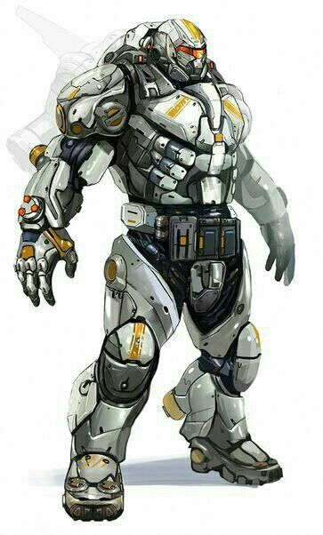
Dialogue:
(Hanz) Why was I fired?
(Boss) Because we had too many “hanz” on deck so we had to let you go.
(Hanz) How dare you!
Action
Player: fights the boss and becomes t he new Ceo, Congratulations! You won!

Slide 10
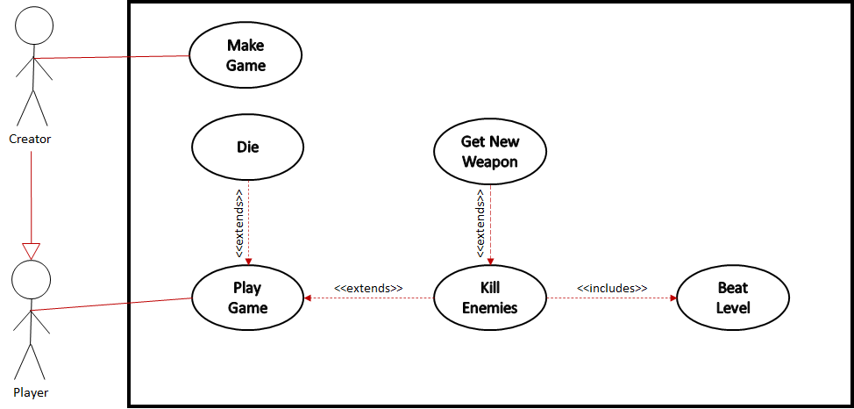
GLOBAL USE CASE

Slide 11
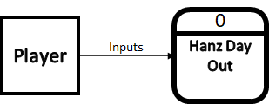
Context Diagram

Slide 12
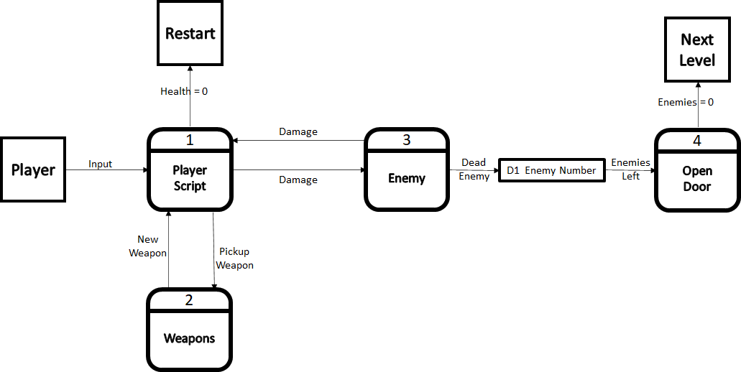
DIAGRAM 0

Slide 13
Team Lead 2: Parker Weisel
Primary Features:
Player Movement, Enemies, Menus, and UI
Feature Priority: Complexity Level:
Very high: Player Movement Low: The movement will be pretty basic.
Moderate: Enemies Moderate: Initially complex but can do some small changes to the initial code to make multiple enemies, but, can be complex depending on what they do.
Moderate: Menus Low: Mostly just basic buttons with a backdrop
Moderate: UI Moderate: Health bar that updates in real time and changes colors depending on how low on life you are.

Slide 14
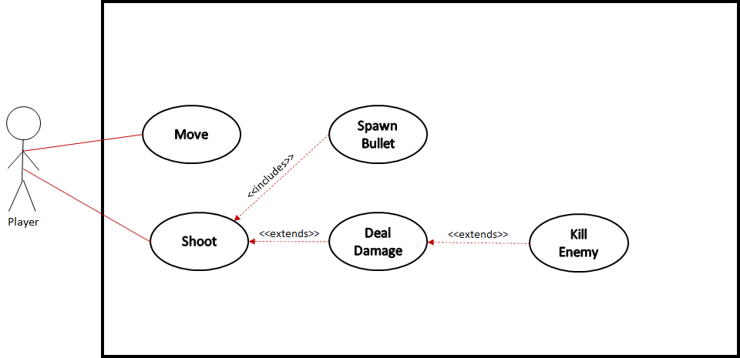
Use Case

Slide 15
Team Lead 3: Jeremy Wisecarver
Primary Features:
RNG drop system, sound design, item pickups, player stats, level design
Feature Priority: Complexity Level:
Very high: Level design Low: The levels will be static
High: Player stats Low: There will be simple number adjustments
Moderate: item pickups High: Items will do things that are “non-standard”
and will build off of things like the shooting script.
Moderate: drop system Moderate: An RNG system will be used
Low: sound design Low: Simple soundtracks and SFX will play

Slide 16
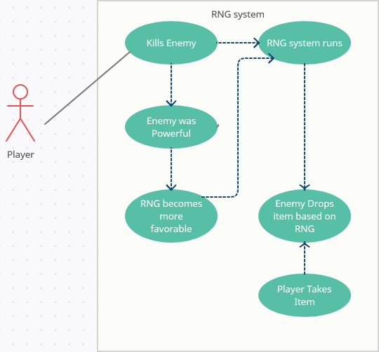
I will be most likely adjusting and replacing this use case after I review it with Beeston :^)
Any Questions or Concerns?

